Slide 1
Boolean Algebra
In 1854, George Boole developed an algebraic system now called Boolean algebra.
Boolean algebra is a system of mathematical logic.
It is an algebraic system consisting of the set of elements (0, 1), two binary operators called OR, AND, and one unary operator NOT.
It is the basic mathematical tool in the analysis and synthesis of switching/digital circuits. It is a way to express logic functions algebraically.
AND Law OR Law
Law1: A.0=0 (Null law) Law1: A+0=A
Law2: A.1=A (Identity law) Law2: A+1=1
Law3: A.A=A (Impotence law) Law3: A+A=A (Impotence law)

Slide 2
Boolean Algebra
Boolean algebra is a useful tool for simplifying digital circuits. • Why do it? Simpler can mean cheaper, smaller, faster.
• Example: Simplify F = x’yz + x’yz’ + xz.
F = x’yz + x’yz’ + xz
= x’y(z+z’) + xz
= x’y•1 + xz
= x’y + xz

Slide 3
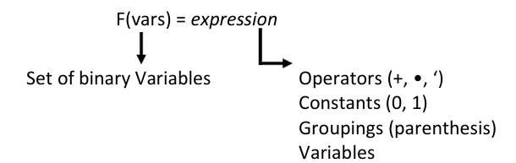
Boolean Function
A Boolean function described by an algebraic expression consists of binary variables, the constants 0 and 1, and the logic operation symbols. For a given value of the binary variables, the function can be equal to either 1 or 0.

Slide 4
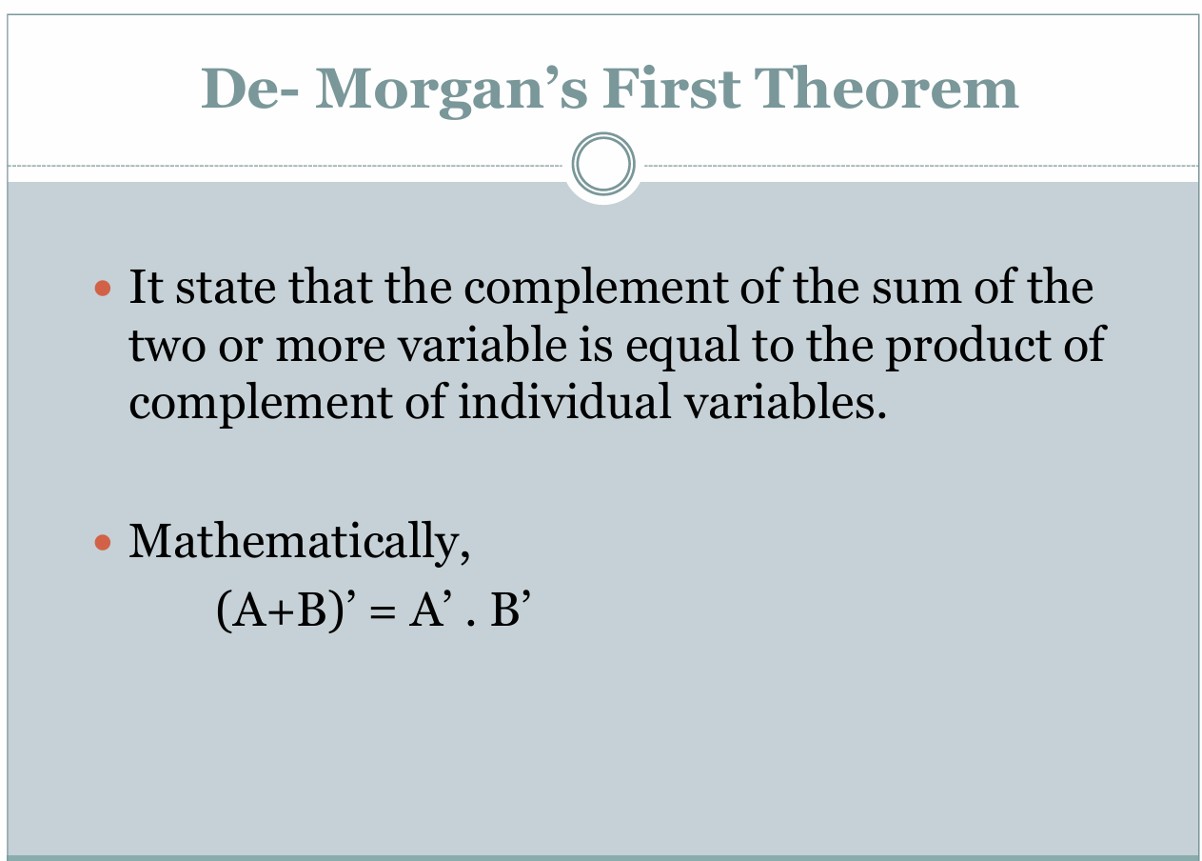

Slide 5
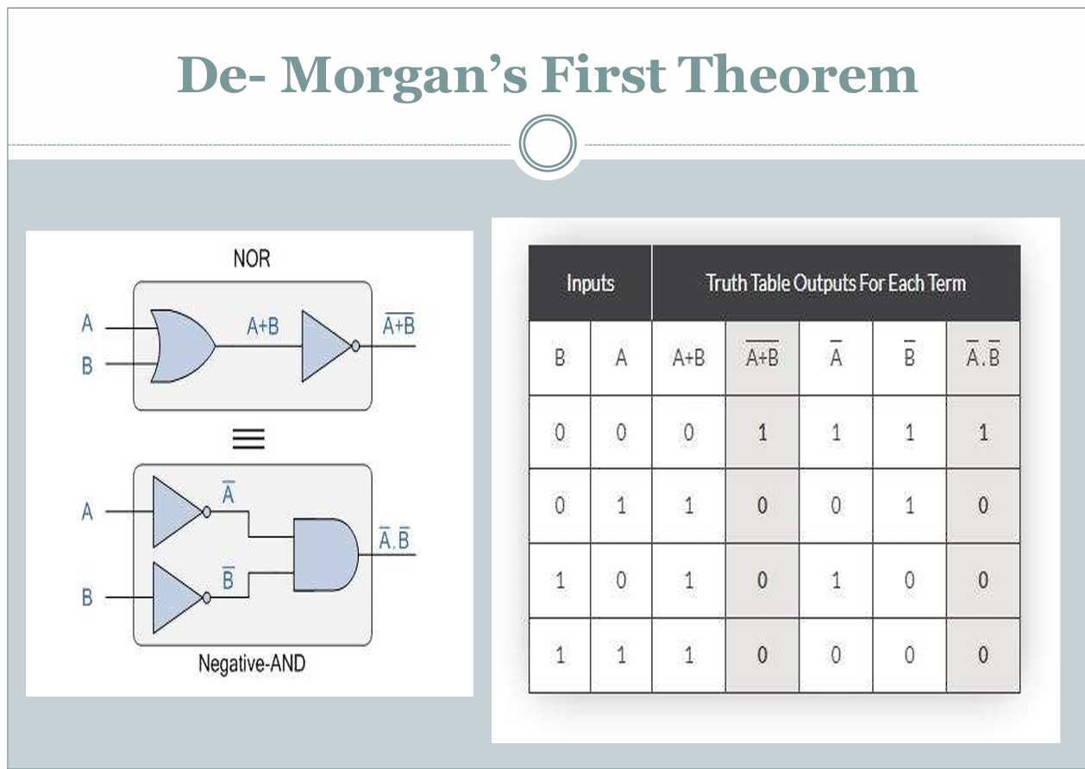

Slide 6
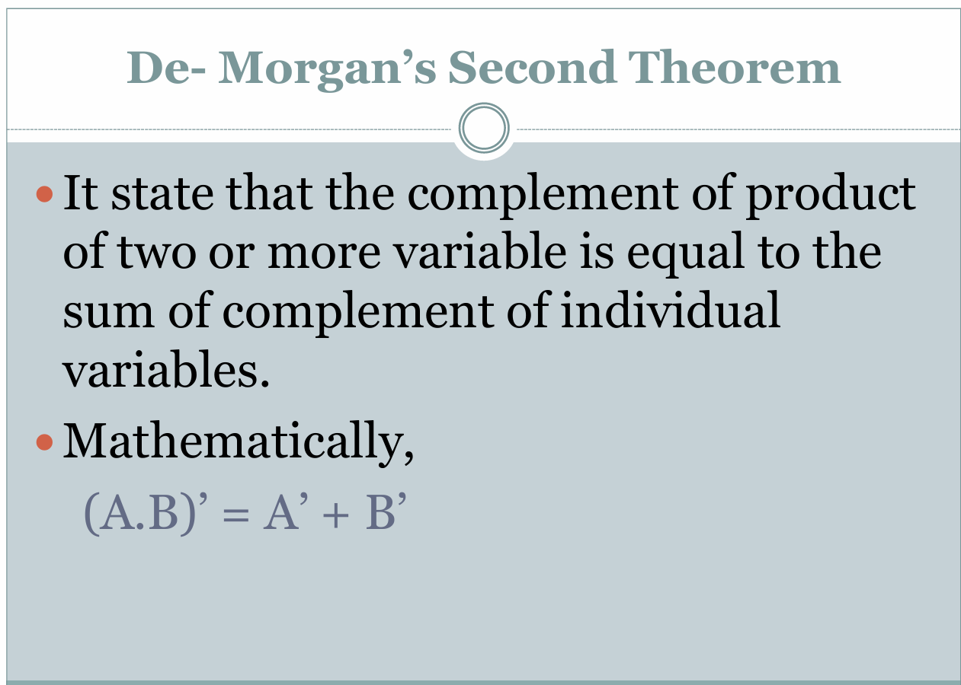

Slide 7
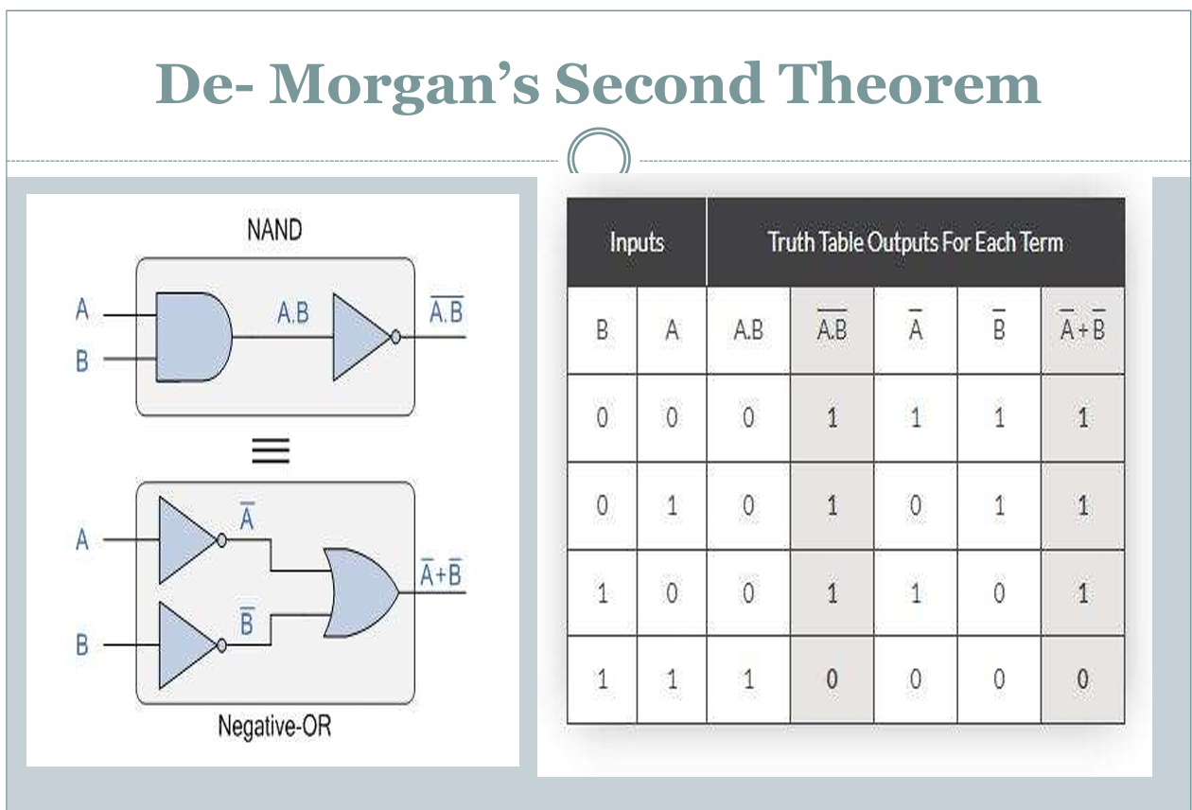

Slide 8
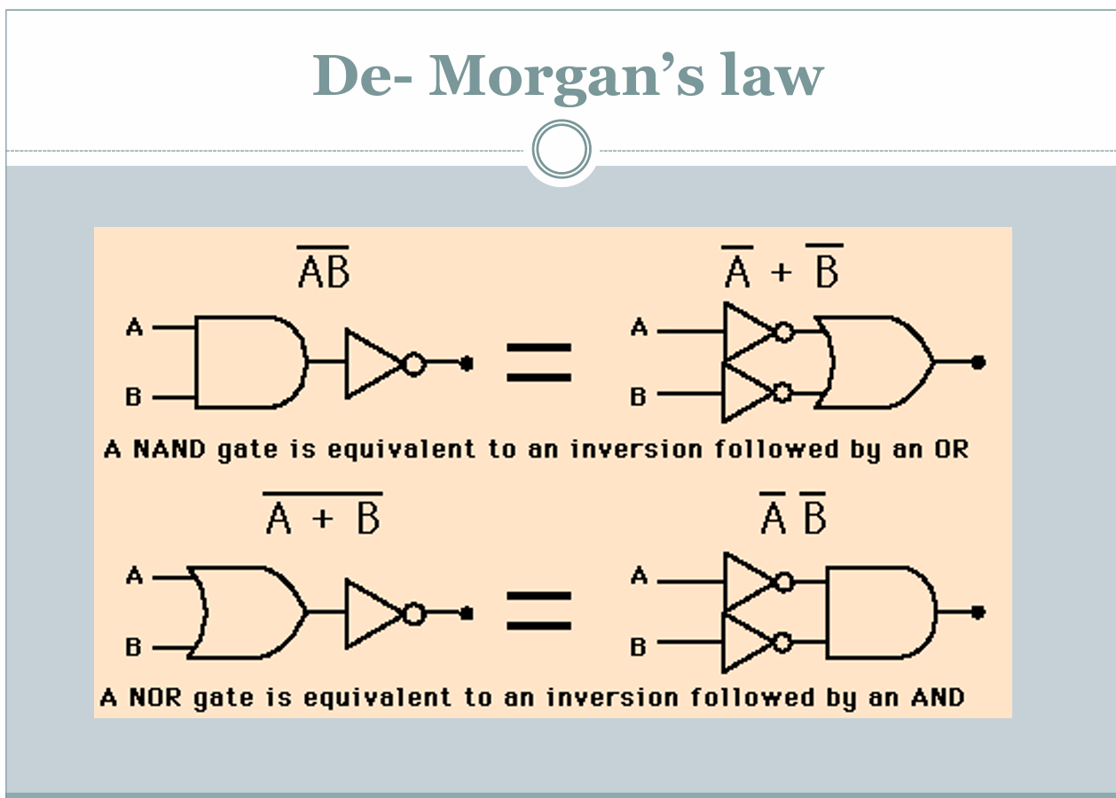

Slide 9
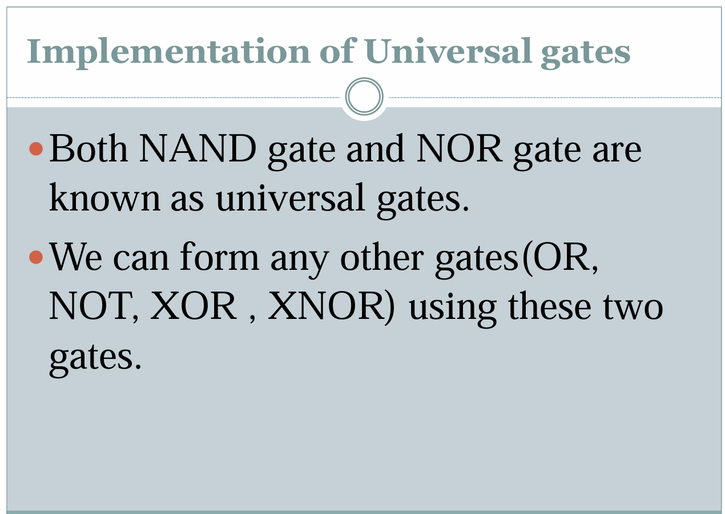

Slide 10
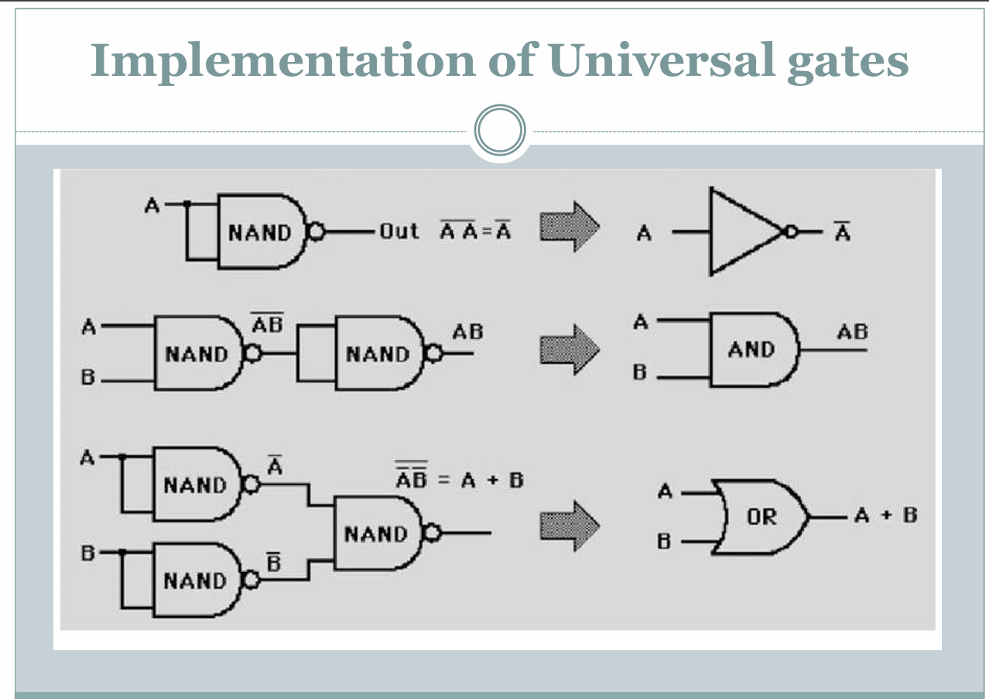

Slide 11
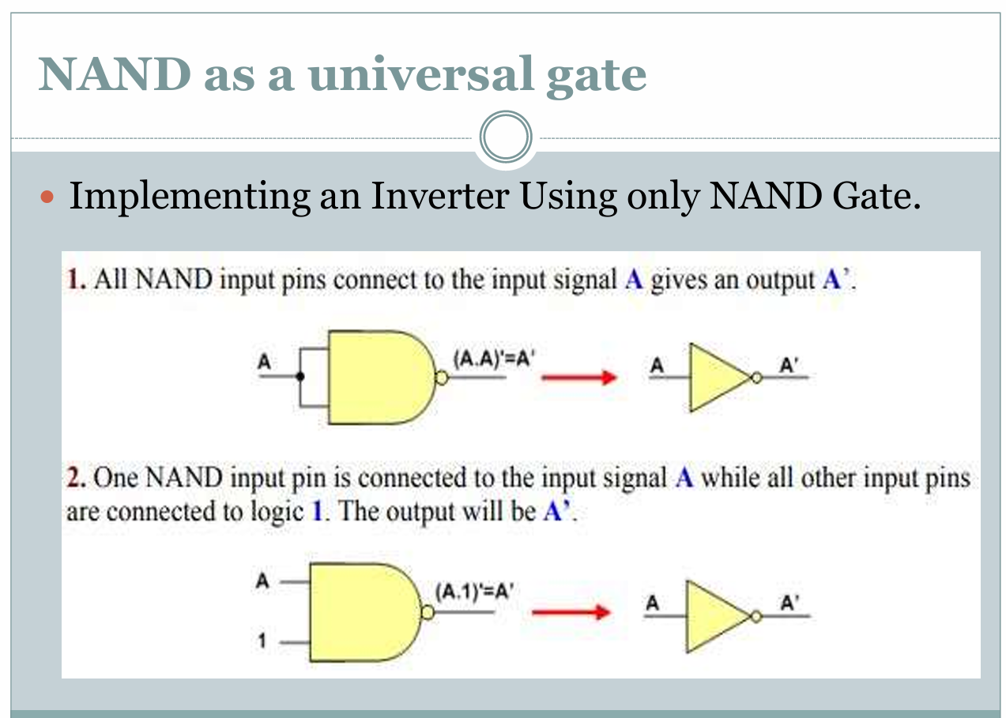

Slide 12
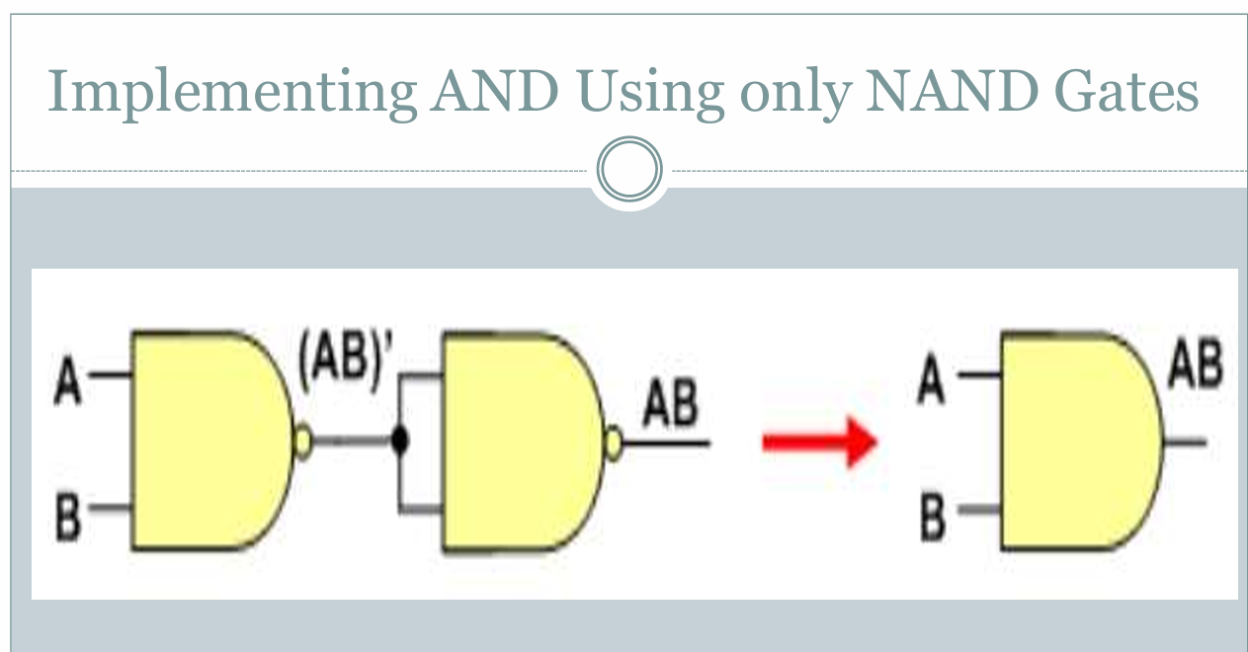

Slide 13
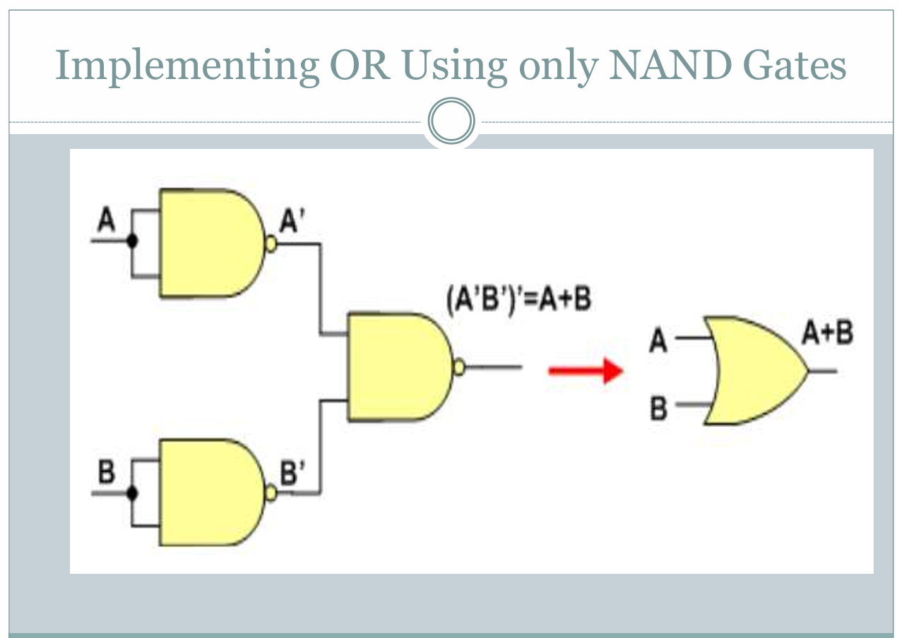

Slide 14
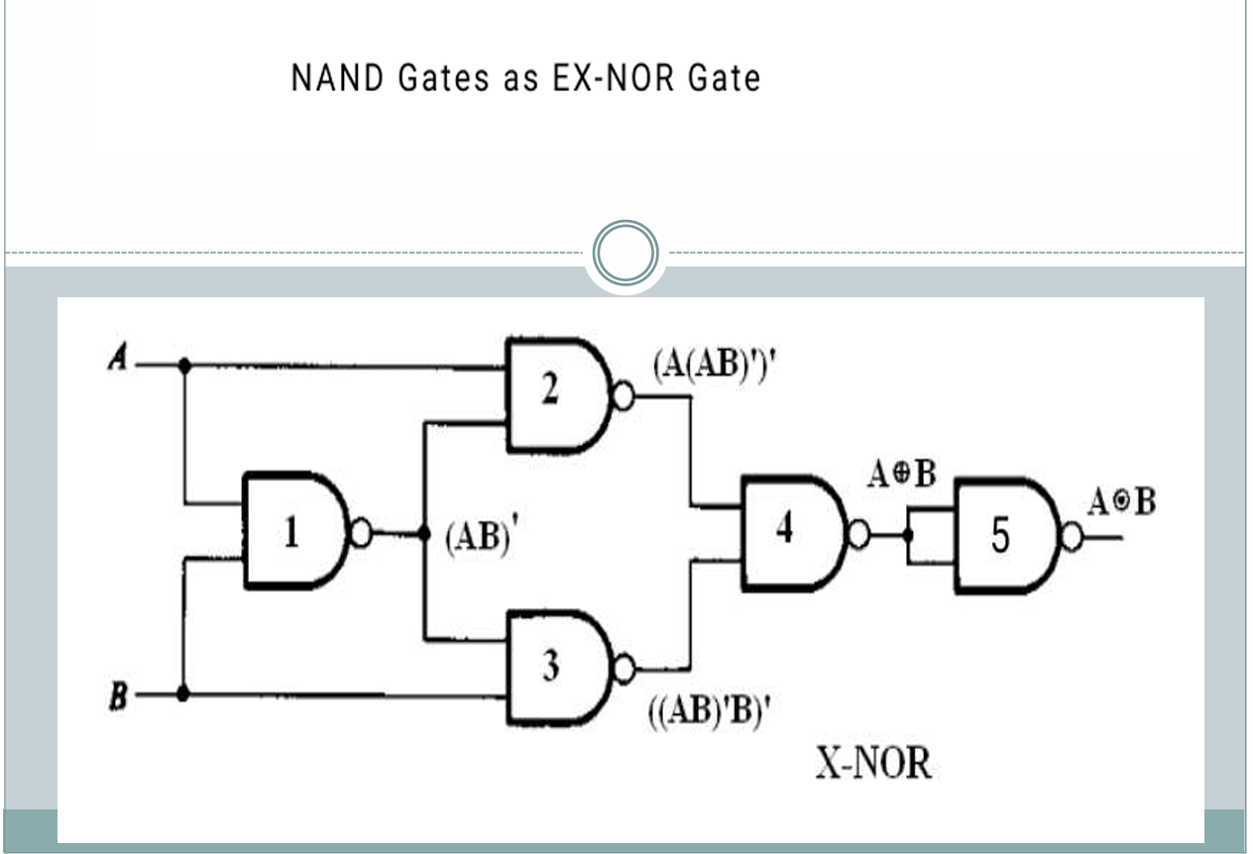

Slide 15
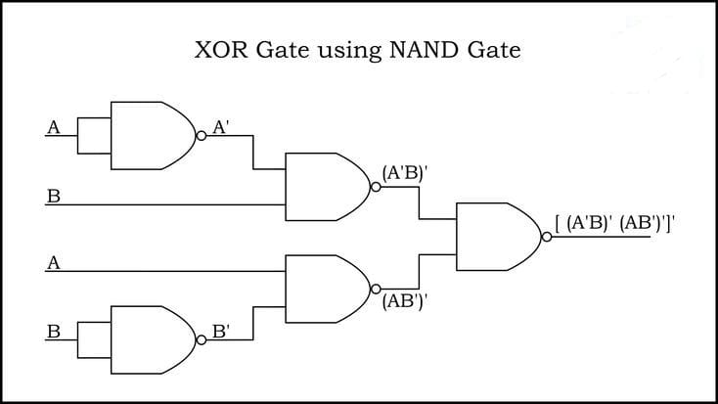

Slide 16
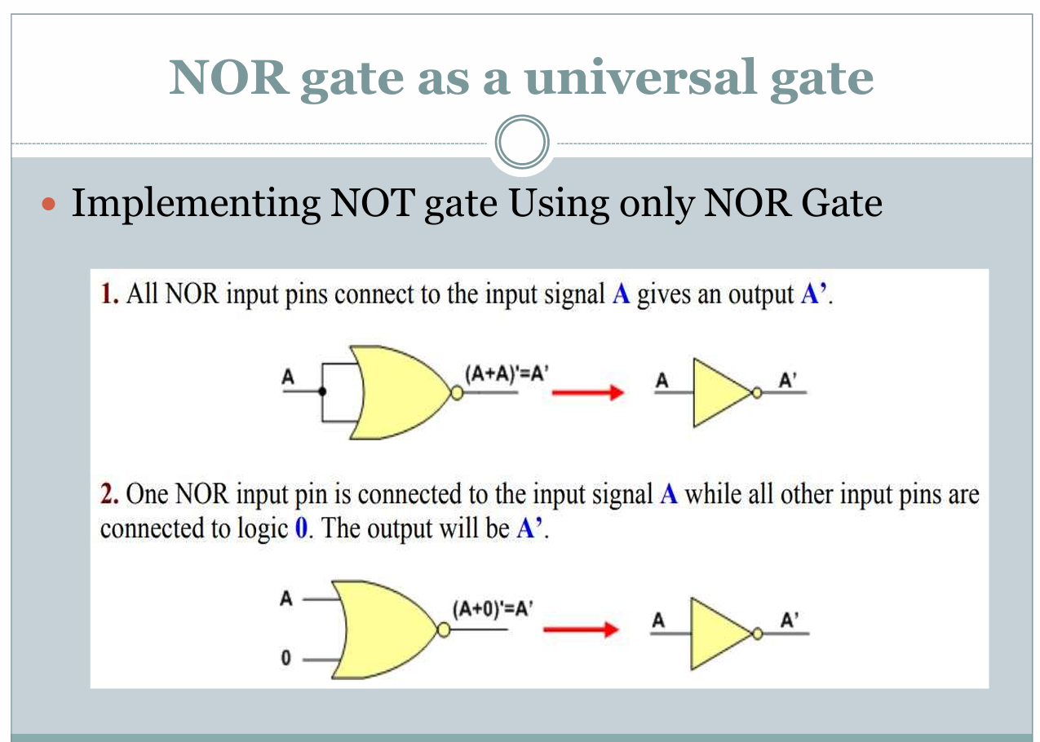

Slide 17
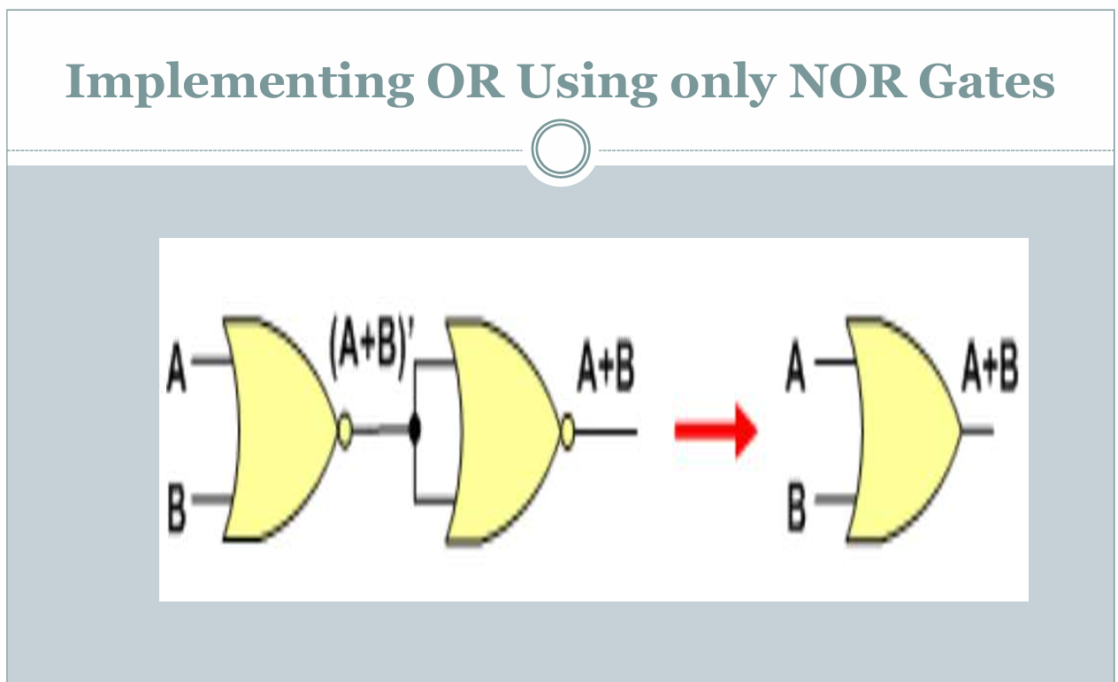

Slide 18
